Slide 1

Edit text and images directly in your own copy after downloading the banner. You can also add your organisation’s logo.
This template is available in English. Replace text and insert a new one with your own translations to other languages.
Once you’ve finalised editing, save the slide as .png or .jpg and use it to spread the word on social media. THANK YOU!

Slide 2
TIPS FOR EDITING THE TEMPLATE
1. Edit the templates directly in your own copy after downloading the banners.
2. Add your organisation’s logo by replacing “Your logo here” placeholder. (Right click of the mouse >> Change picture …)
3. You can insert your own photo by pressing down the right mouse button and selecting ‘Change picture’.
4. Once finished, go to FILE in the menu and save it to your device as a JPG or PNG.

Slide 3

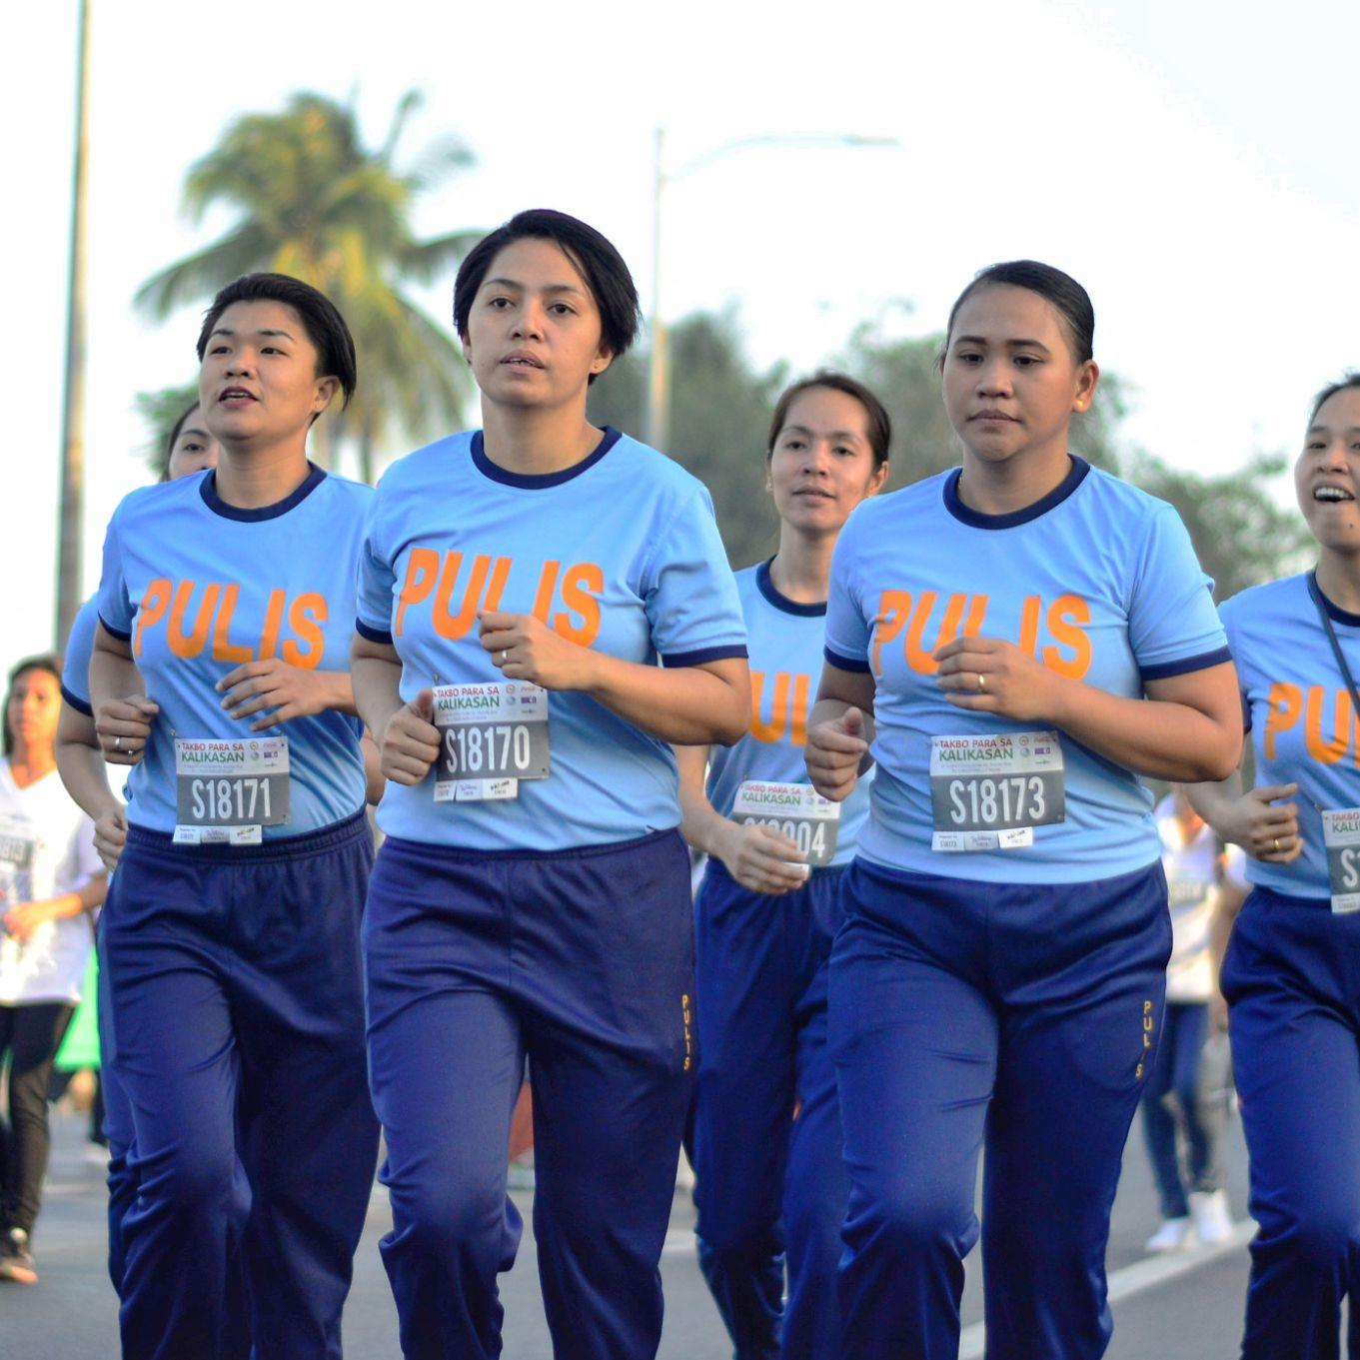


It’s time for governments to spark change. Fast-tracking national implementation of NCD policy recommendations will drive progress towards universal health and well-being, ensuring no one is left behind. It’s time to lead.

Slide 4

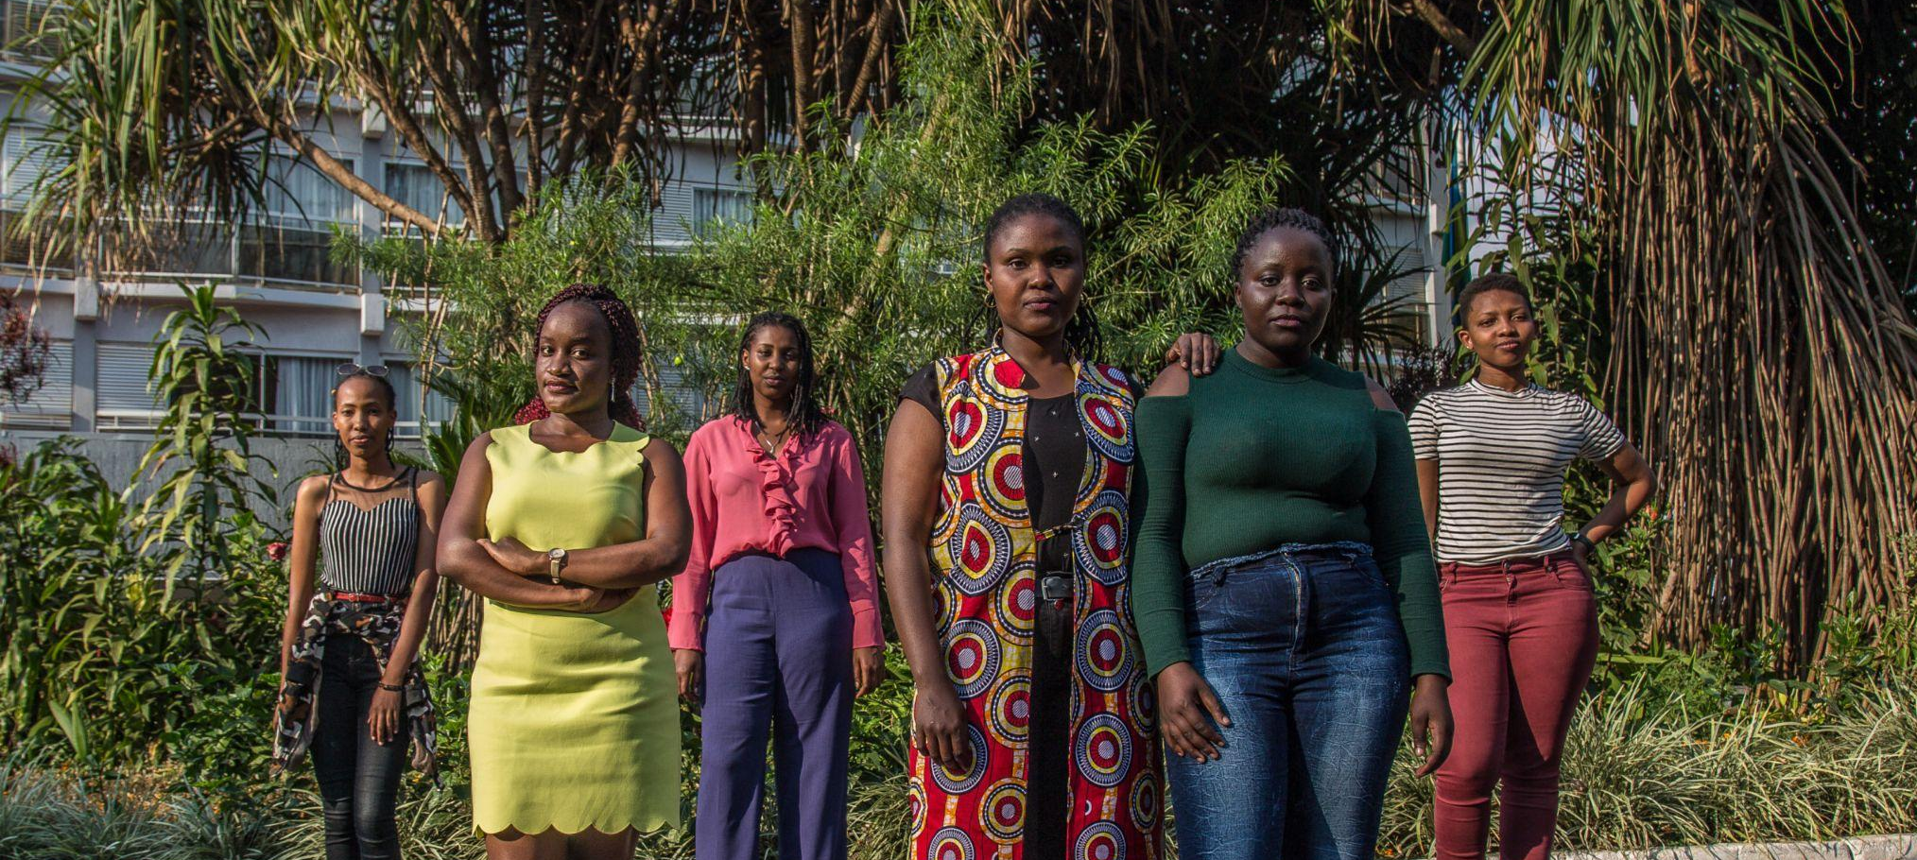

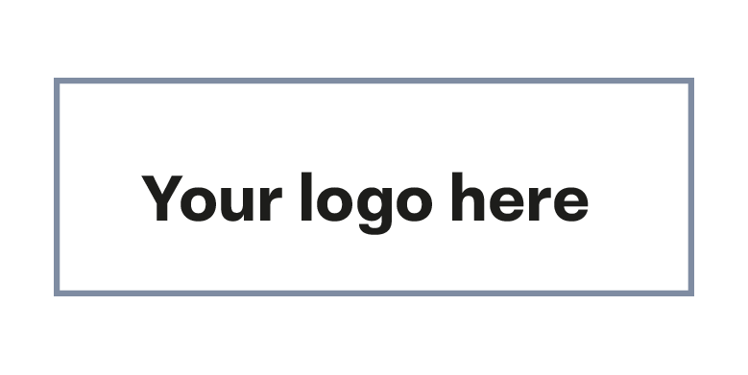
#LeadOnNCDs
#ActOnNCDs
If the global community is to meet Sustainable Development Goal targets for 2030, NCDs must be urgently addressed. It's time for decision-makers to prioritise equity and take proactive steps towards a fairer world.

Slide 5

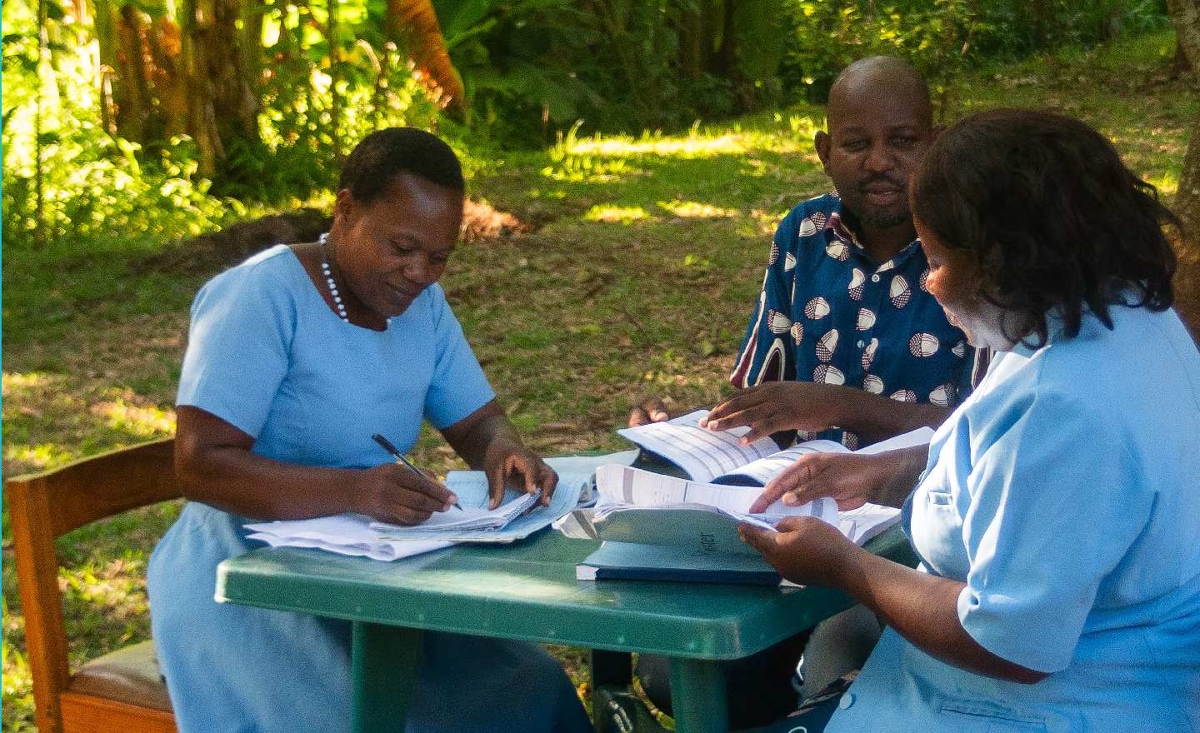


We need leaders who will help deliver a positive result following last year’s High-Level Meeting on NCDs and Mental Health. We need country leaders, community leaders and civil society leaders to step up. Together, we can spark the necessary change for NCDs.
#LeadOnNCDs
#ActOnNCDs

