Slide 1
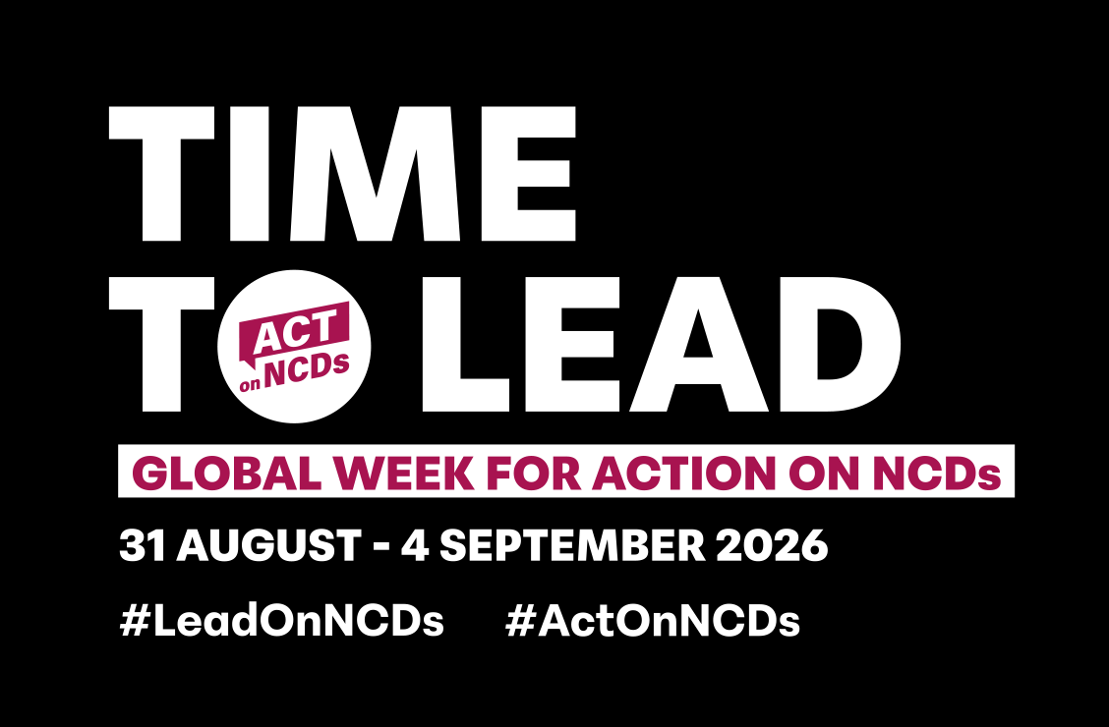
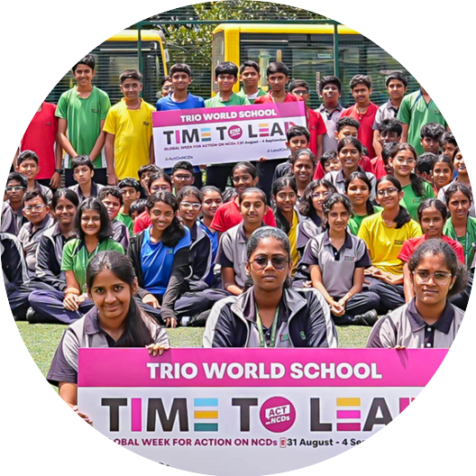

2026 Impact Report
Leadership in Focus:
From Commitment to Implementation
October 2026
#LeadOnNCDs
#ActOnNCDs

Slide 2
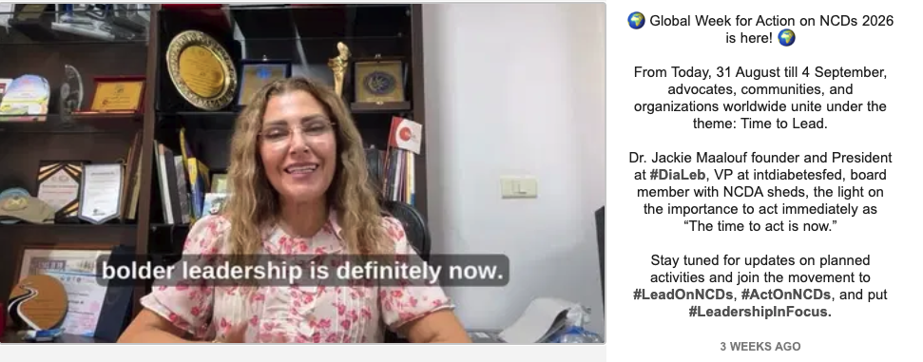
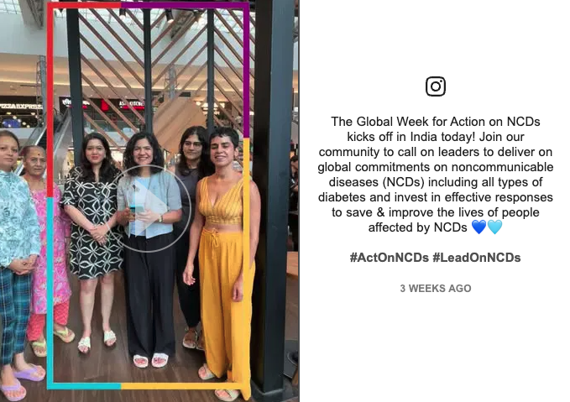
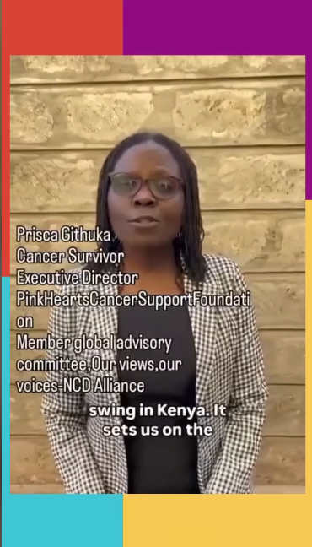
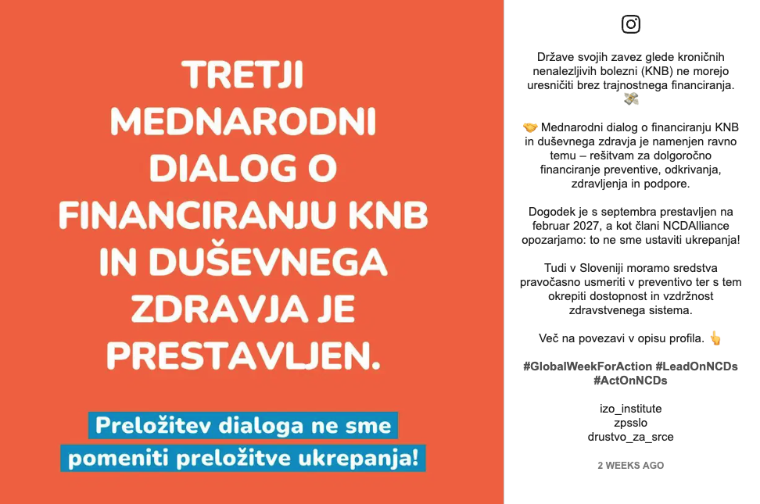
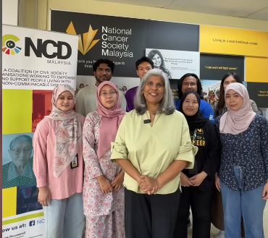
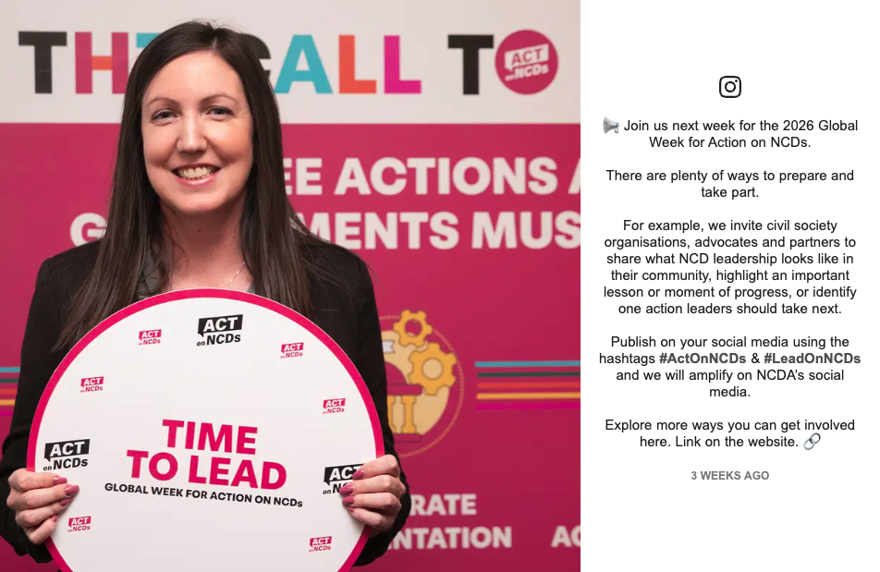

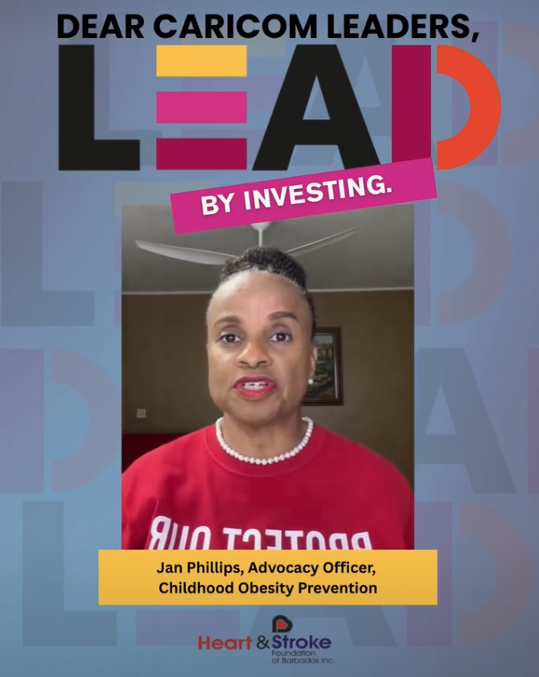
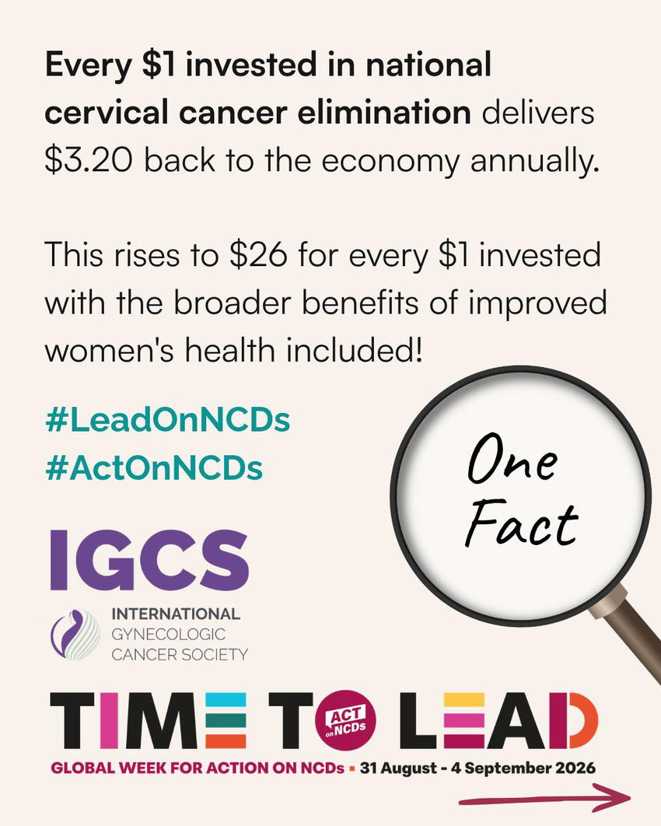
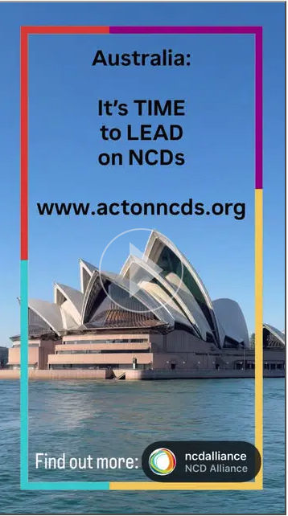
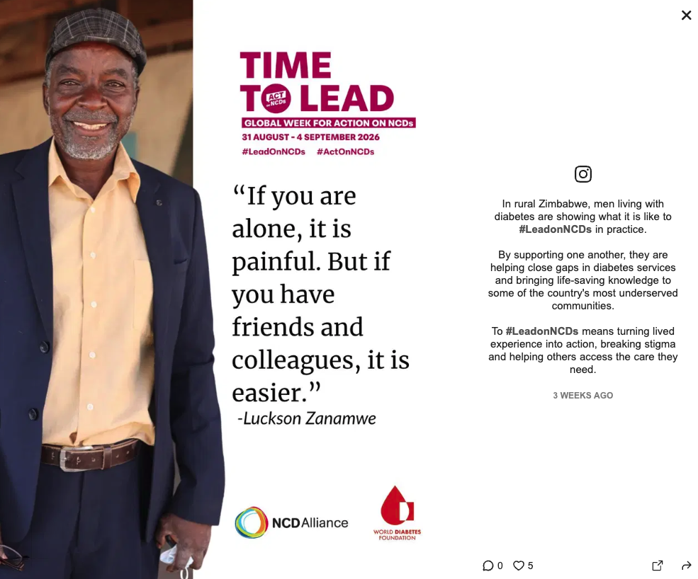
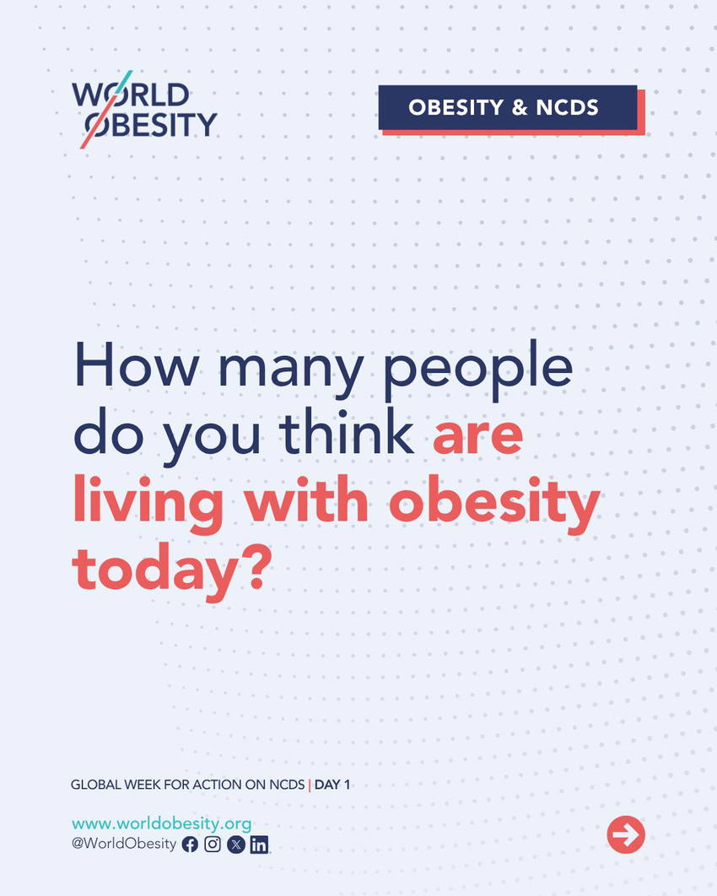
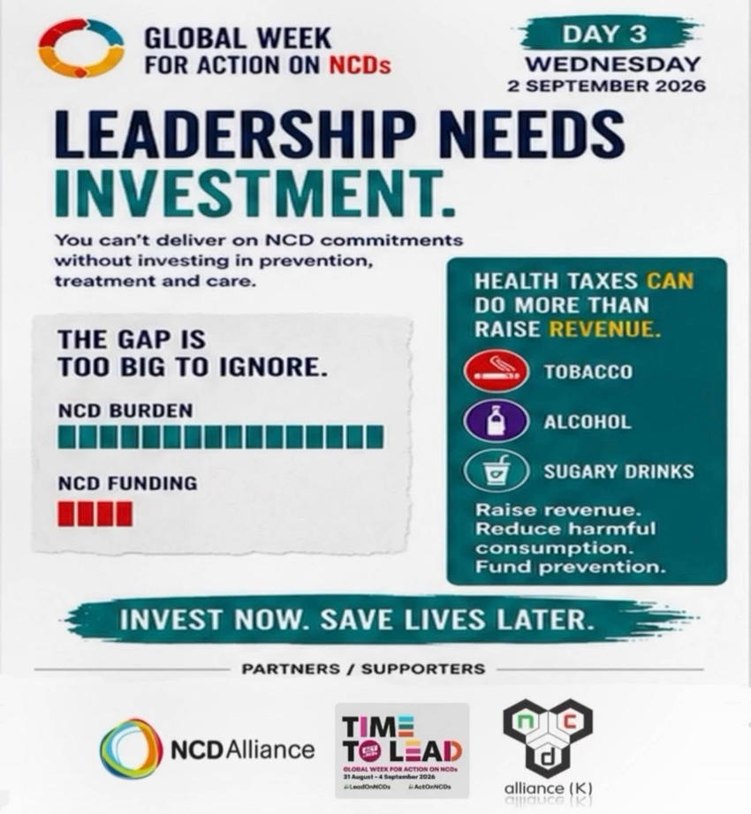

Slide 3
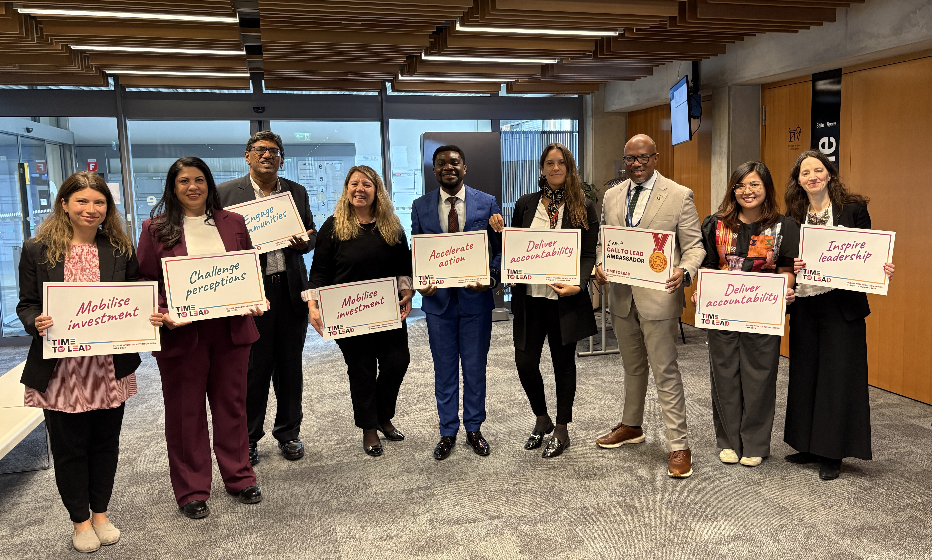
TABLE OF CONTENTS
Message from the CEO……………………………..…
A Special Thank you to You………………………….
Acknowledgements…………………………………….
Community Activation – Key Metrics………….
Time to Lead……………………………………………….
The Campaign Journey………………………………..
Campaign Priorities……………………………………..
Advocacy in action………………………………………
Government Champions……………………………..
NCD Financing Tracker…………………………………
Stories of Impact…………………………………………
One Message, Multiple Voices……………………
Member and Support engagement………
Storytelling assets………………………………………..
Blogs and Multimedia Content…………………….
Knowledge Exchange……………………………………
Digital engagement and analytics………………..
Looking forward…………………………………………..
4
5
6
7
8
9
10
11
12
13
14
16
17
18
20
21
22
24
2026 Global Week for Action Impact Report
2

Slide 4
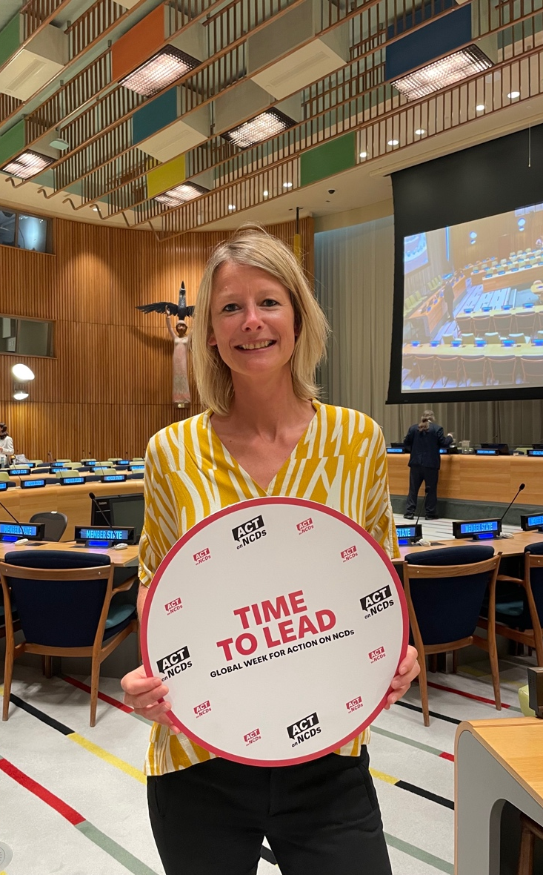
MESSAGE FROM THE CEO
The Global Week for Action on NCDs is powered by people. This year, the NCDA Board of Directors and staff, our members and supporters, national and regional NCD alliances, Our Views, Our Voices Advisory Committee, NCD diarists, advocates and partners around the world each helped bring the campaign to life.
The week opened with a World Tour of videos from members and supporters, carrying voices and perspectives from across our global community. At the time of writing, more than 380 events and activities had been captured worldwide, with new reports still coming in. Stories, resources and advocacy throughout the week kept the experiences of people living with NCDs at the heart of the campaign.
The postponement of the 3rd International Dialogue on Sustainable Financing for NCDs and Mental Health changed the campaign’s immediate destination, but not its urgency. The launch of the NCD Financing Tracker marked the next step on the Road to Manila and created a new opportunity for our global network to document and encourage progress on NCD financing.
None of this would have been possible without you. Whether you shared a story, organised an activity, contributed your expertise, amplified the campaign or supported it in other ways, you gave the Global Week its reach, relevance and strength.
What made this year’s Global Week so powerful was not any single activity, voice or organisation, but the way each contribution strengthened the whole.
Katie Dain, CEO, NCD Alliance
Geneva, October 2026
2026 Global Week for Action Impact Report
4

Slide 5
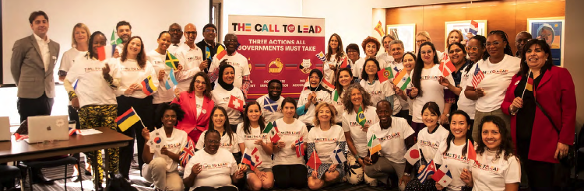
A SPECIAL THANK YOU TO YOU
This year’s Global Week for Action on NCDs marks the beginning of the final leg of what has become a three-year Time to Lead campaign. The campaign carried our movement through the fourth UN High-Level Meeting on NCDs and Mental Health (HLM4) and now takes us forward on the Road to Manila, keeping the focus firmly on the financing and leadership needed to turn commitments into action.
Now in its ninth year, the Global Week has become much more than a single moment of mobilisation. It provides a platform for our community to sustain pressure, share solutions and keep the experiences of people living with NCDs at the centre of the global response. The strength of engagement we have seen from around the world this year reflects a movement that is not only growing in reach, but deepening in commitment.
As this report shows, the NCD community continues to find new ways to lead, from organising activities and sharing lived experiences to developing practical resources and holding governments accountable. Every contribution adds momentum to the next. As we enter this final stretch of Time to Lead, we do so with renewed determination. The Road to Manila gives us another opportunity to build on what this community has created and press for concrete progress on sustainable financing for NCDs and mental health.
Gina Sanchez
Campaign Coordinator
2026 Global Week for Action Impact Report
5

Slide 6
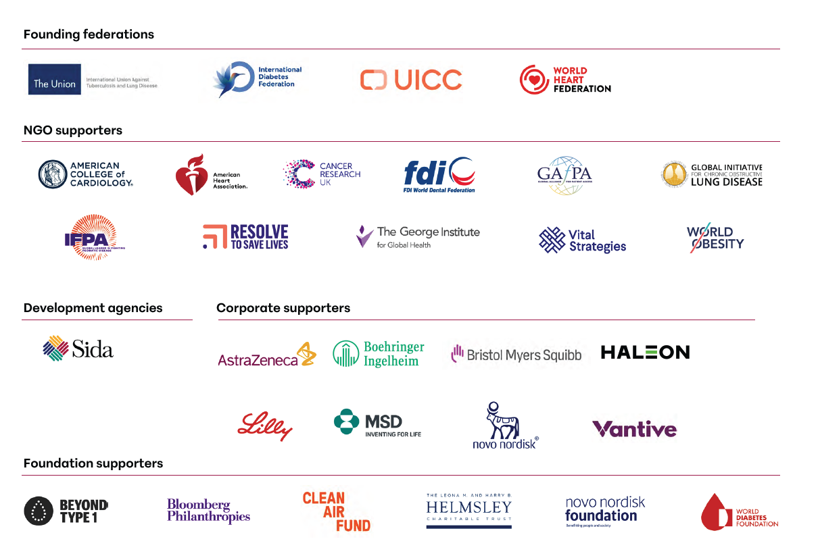
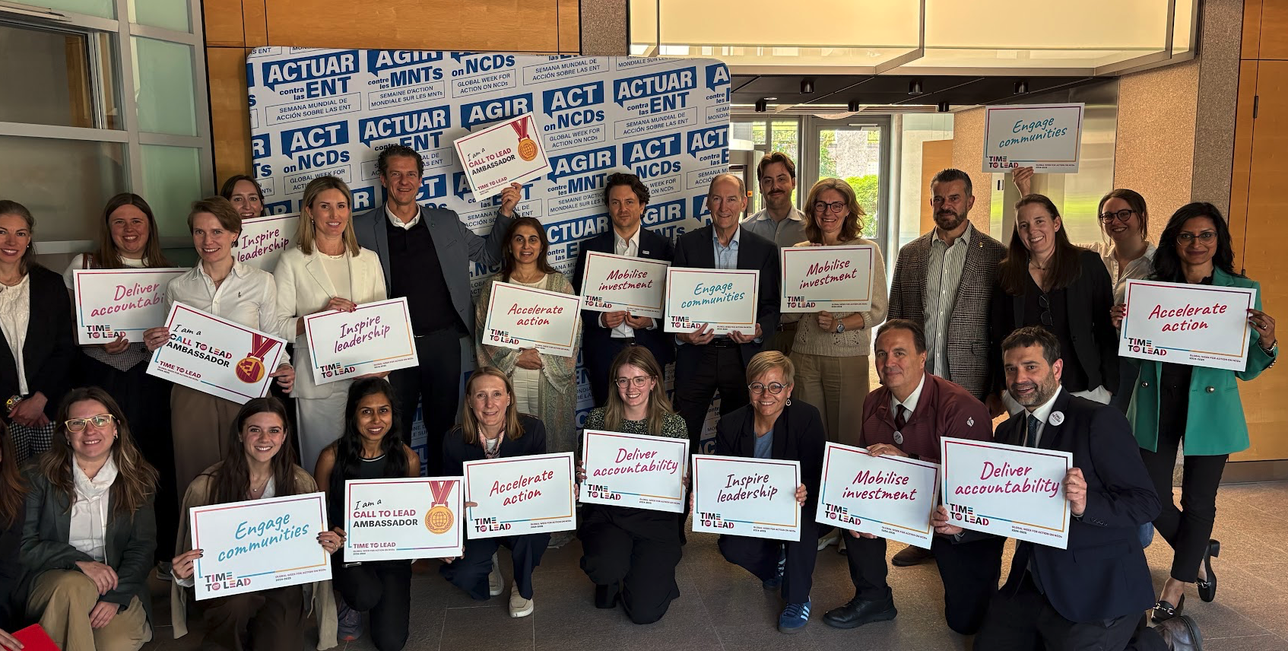
ACKNOWLEDGEMENTS
Campaign supporters
Thanks to the financial commitment, engagement and campaign amplification provided by NCD Alliance supporters. Leveraging multisectoral action and inclusive partnerships is at the core of how NCDA operates and delivers results in the global fight against NCDs.
NCDA supporters include forward-thinking governments, NGOs, philanthropies, companies, and academia that have an international focus on NCDs and share a common interest in improving the lives of people living with NCDs globally.
2026 Global Week for Action Impact Report
6

Slide 7
COMMUNITY ACTIVATION - KEY METRICS*
WEBSITE
SOCIAL MEDIA
COMMUNITY ACTIVATION
90,966
18.8m
880+
users
people reached with #ActOnNCDs
and/or #LeadOnNCDs
events and activities
recorded worldwide
149,962 sessions
7,984,000 views
35% engagement rate
Still counting
95,000 interactions
above sector median
Campaign activity continued to be submitted after the Global Week closed.
6% avg monthly engagement rate
above sector median
*These numbers are for the three-year campaign, 15 Sep – 11 Nov 2024, 18 Aug – 2 Oct 2025 and 1 July – 30 Sept 2026 combined.
2026 Global Week for Action Impact Report
7
Notes:
Metrics supplied in the draft report. Community activation remains a live count.

Slide 8
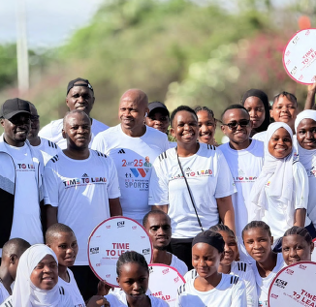
TIME TO LEAD
Three years of action
Time to Lead began in 2024 as a two-year campaign leading towards the fourth UN High-Level Meeting on NCDs and Mental Health (HLM4). It gave the global NCD movement a shared platform for calling on governments to demonstrate leadership through concrete action.
In 2026, the campaign entered a third and final phase. Under the theme Leadership in Focus: From Commitment to Implementation, attention shifted towards the financing and accountability needed to turn political commitments into measurable progress.
The final leg of Time to Lead will conclude at the third International Dialogue on Sustainable Financing for NCDs and Mental Health (IFD3) in the Philippines in February 2027, before dovetailing into NCDA’s next long-term campaign strategy.
LEADERSHIP IN FOCUS
From Commitment to Implementation
2026 Global Week for Action Impact Report
8

Slide 9
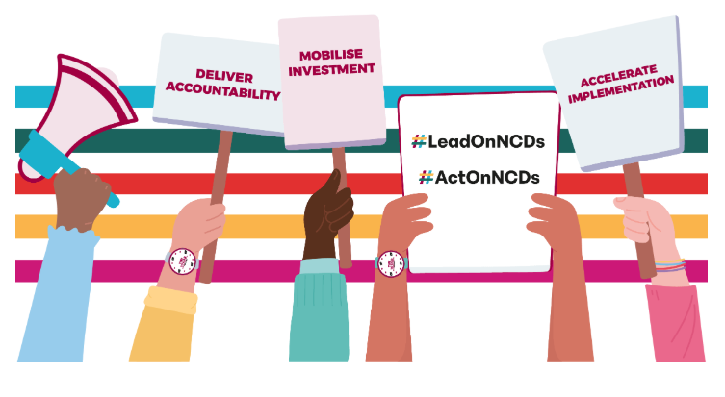
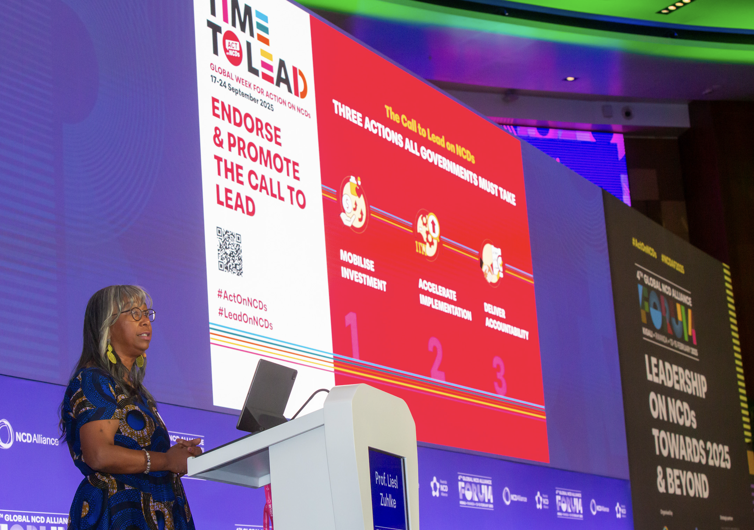
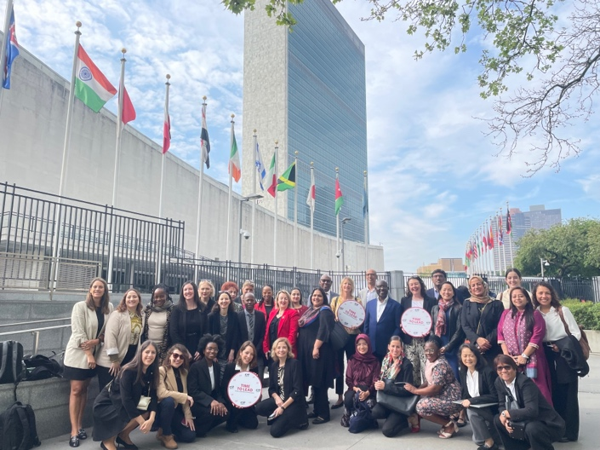

THE CAMPAIGN JOURNEY
2024
2025
2026–FEB 2027
CALLING FOR LEADERSHIP
TAKING THE CALL TO HLM4
FROM COMMITMENT TO IMPLEMENTATION
Time to Lead brought the NCD movement together around five campaign priorities. The Call to Lead became its central advocacy statement, inviting organisations, advocates and individuals worldwide to demand genuine leadership on NCDs and mental health.
The campaign carried these shared demands into the negotiations surrounding HLM4. The resulting Political Declaration introduced important global targets, but left significant gaps in financing and accountability.
Leadership in Focus asked what governments were doing to finance their commitments, how progress could be documented and where further action was needed. The Road to Manila will carry this focus through to IFD3.
2026 Global Week for Action Impact Report
9

Slide 10
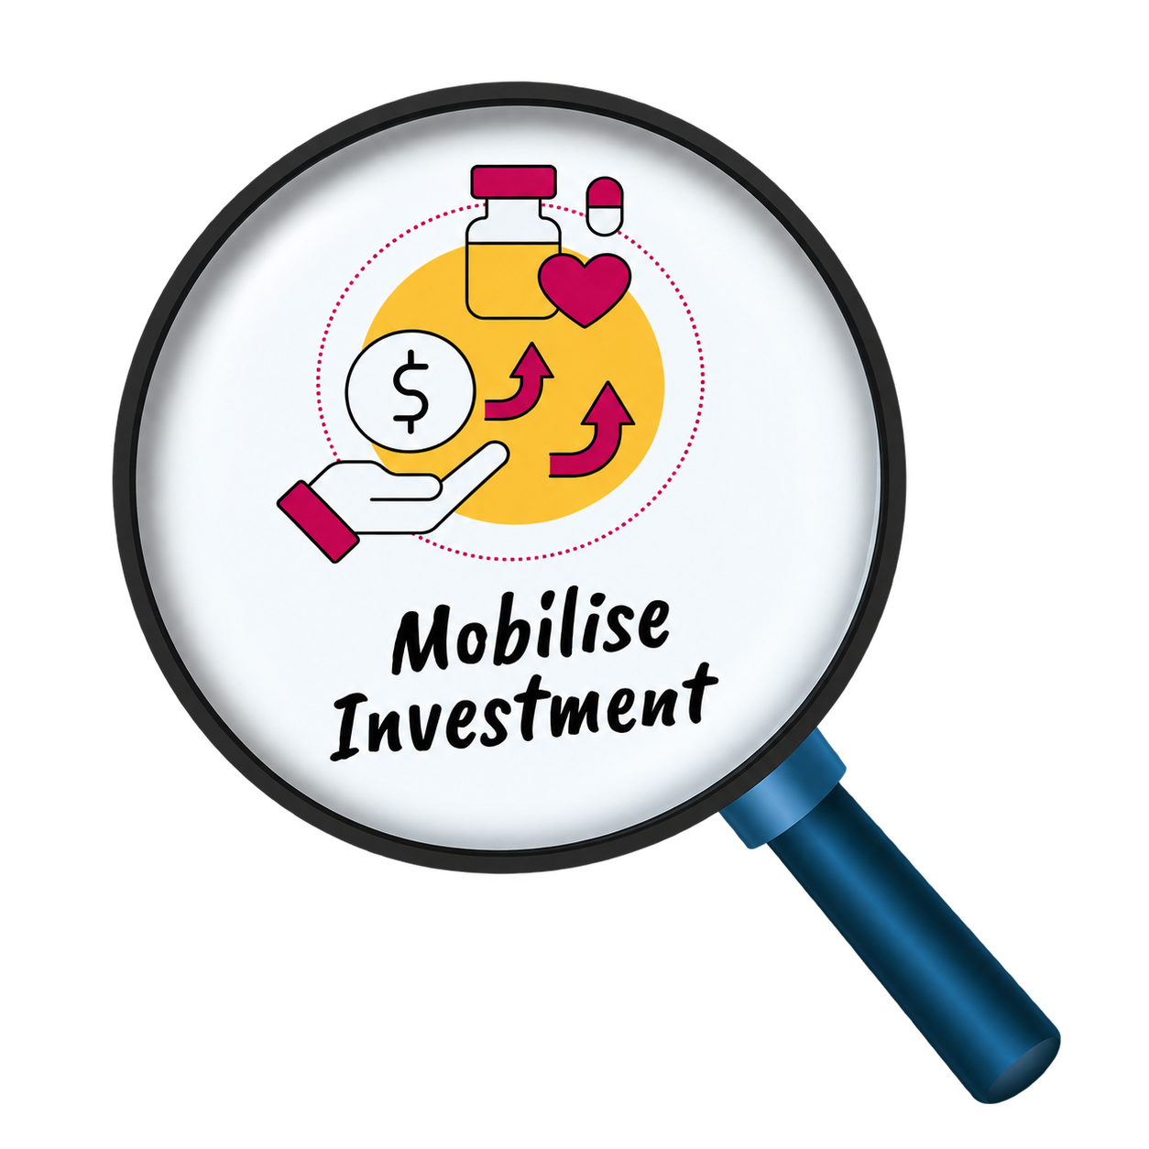
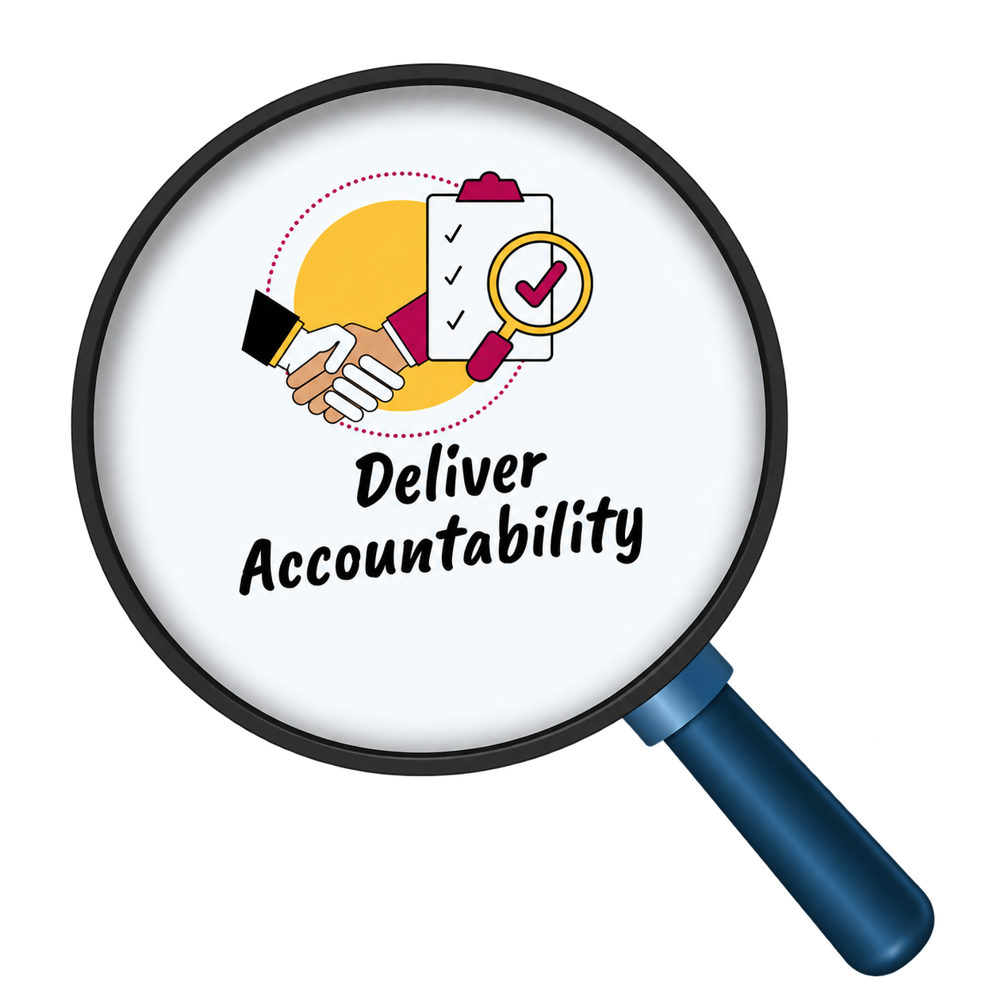
CAMPAIGN PRIORITIES
1
Accelerating the implementation of proven NCD policies and interventions
2026 FOCUS
2
Integrating NCDs across health and development agendas
3
Mobilising sustainable investment across prevention and care
4
Delivering accountability for national and global commitments
5
Engaging communities and people living with NCDs in decisions that affect their health
2026 Global Week for Action Impact Report
10

Slide 11
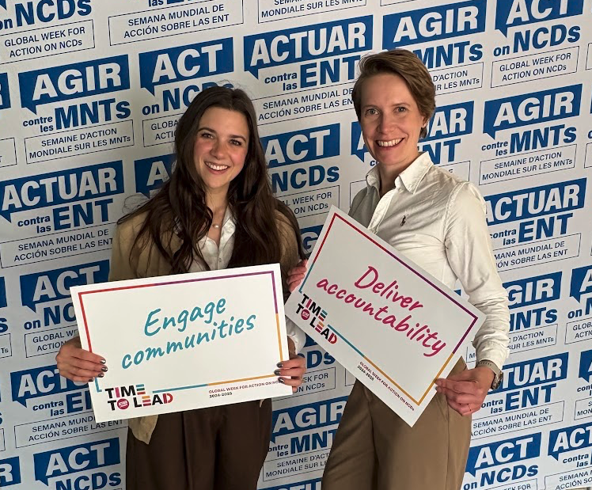
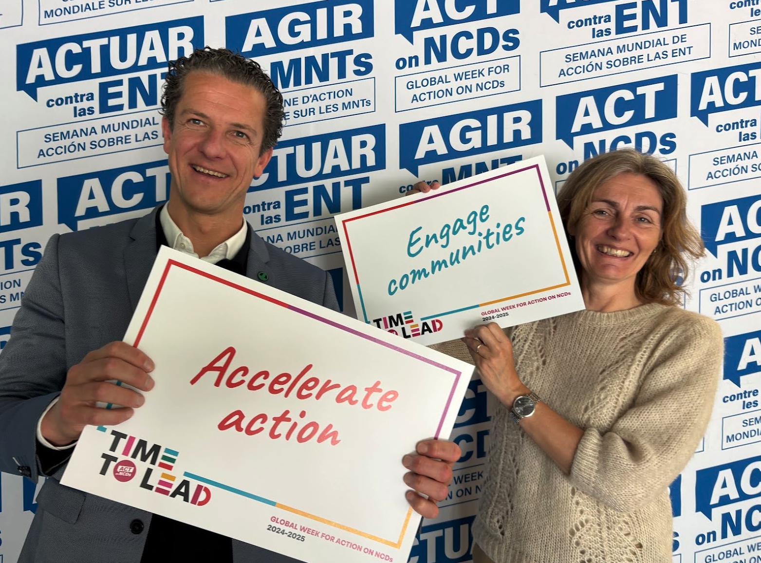
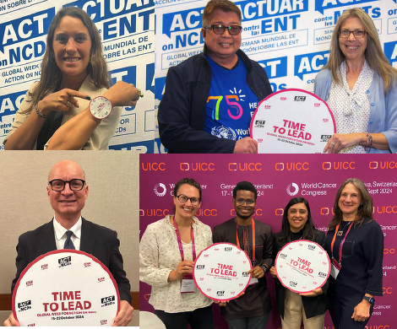
ADVOCACY IN ACTION
Across its three years, Time to Lead connected global policy moments
with national and community action. It provided a common narrative
through which members and supporters could bring lived experience,
policy evidence and campaign demands into the same conversation.
The official launch of The Call to Lead marked the closing of the Global NCD Alliance Forum in February 2025 and gave the movement a shared demand ahead of the HLM4 in September. National and regional alliances adapted its messages to their contexts, while people living with NCDs helped ensure that the campaign remained grounded in the realities of
accessing prevention, treatment and care.
Following the HLM4, the campaign moved from calling for
commitments to examining what governments were doing to deliver
them. This shift shaped the 2026 Global Week and led to the creation
of the NCD Financing Tracker.
2026 Global Week for Action Impact Report
11

Slide 12
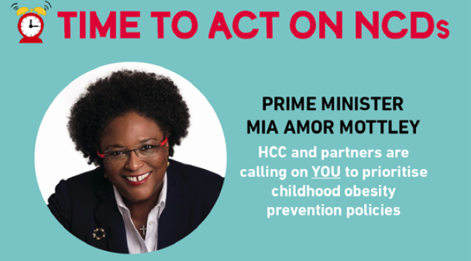
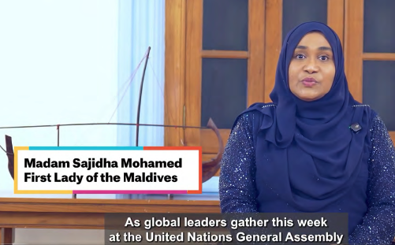
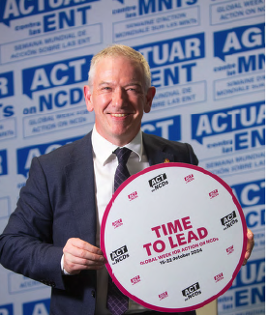
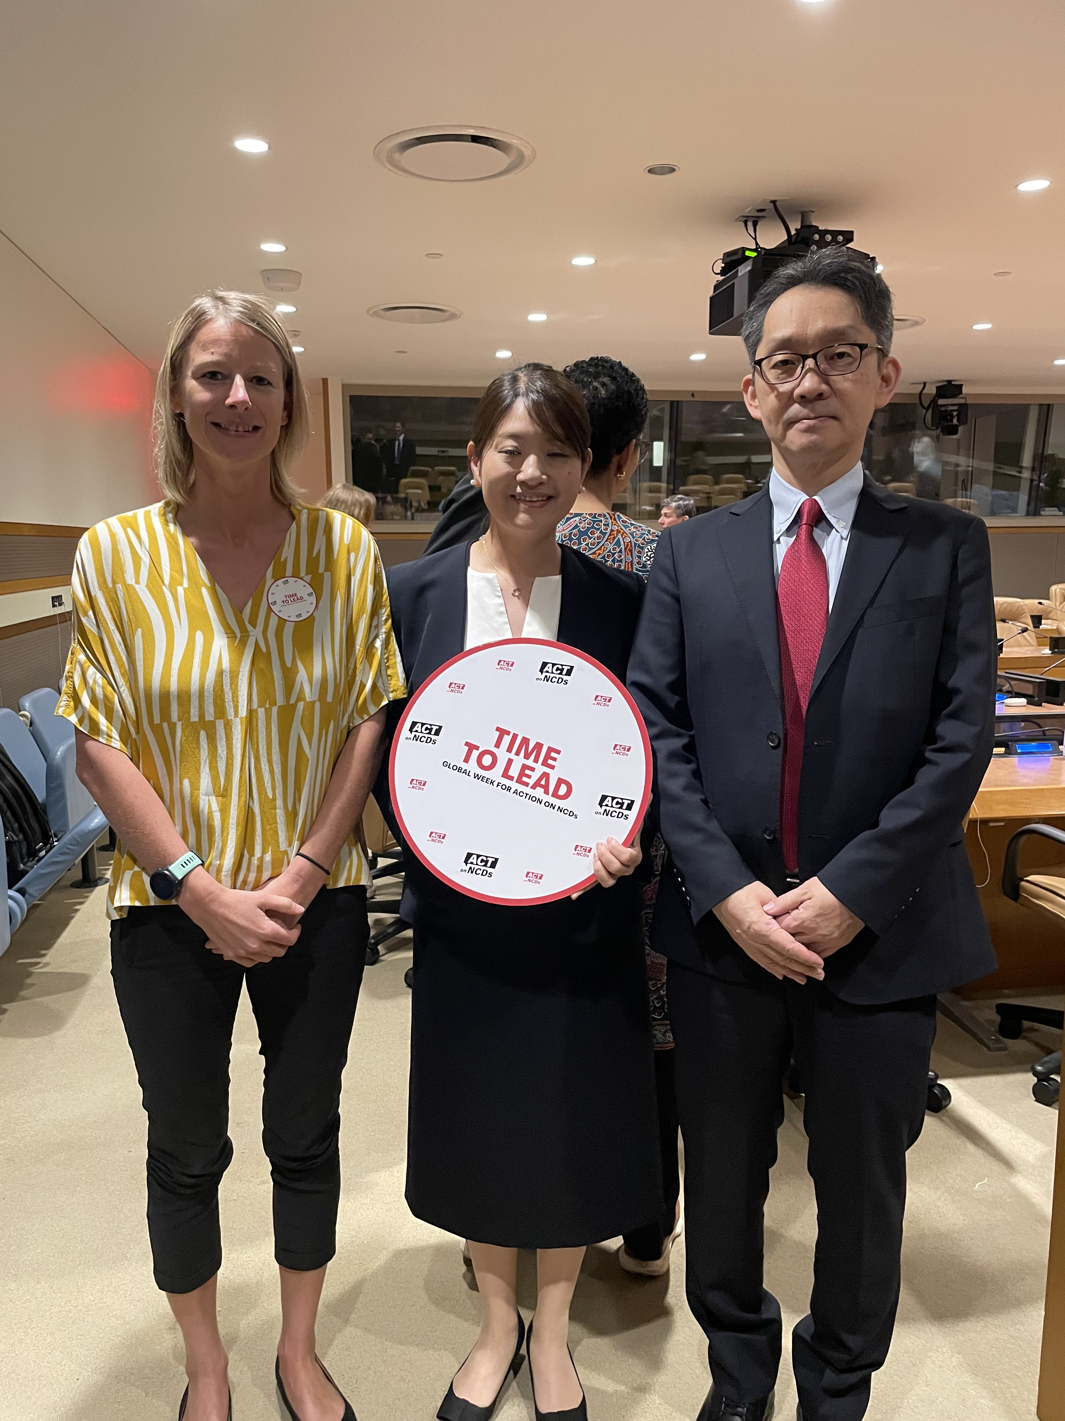
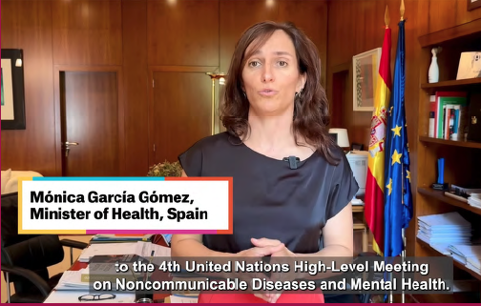
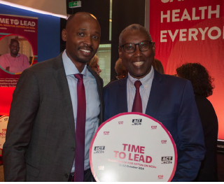
GOVERNMENT CHAMPIONS
At least 13 governments publicly supported the Global Week, including Barbados, Indonesia, Japan, Luxembourg, Malawi, Maldives, Norway, Scotland, Spain, St Kitts and Nevis, Rwanda, Thailand, and Uruguay.
Beyond these visible champions, many other governments engaged throughout the campaign cycle in less public but equally meaningful ways.
These interactions strengthened cross-regional collaboration and reinforced shared priorities across diverse political and geographic contexts.
2026 Global Week for Action Impact Report
12

Slide 13
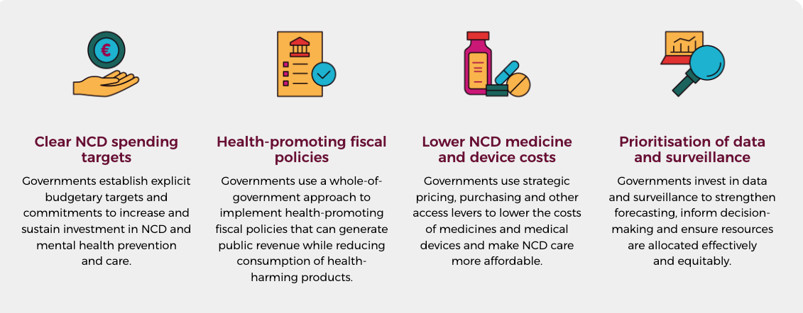
NCD FINANCING TRACKER
Showcasing country action to finance the NCD response
The Political Declaration adopted at the HLM4 left major questions about how governments would finance their commitments and demonstrate progress. NCDA launched the NCD Financing Tracker to bring examples of government action together and make them more visible. Rather than assessing or ranking countries, it provides an illustrative snapshot of leadership across four areas.
Behind each entry is a story about how progress happens. By drawing these examples together, the Tracker gives advocates evidence they can use, helps promising approaches travel between countries and encourages governments to take further action. The Tracker will continue to grow as the NCD community submits examples. Its findings will be shared at IFD3 in the Philippines in February 2027.
2026 Global Week for Action Impact Report
13

Slide 14
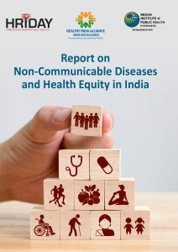
STORY of
IMPACT
The Healthy India Alliance, together with HRIDAY and the Indian Institute of Public Health Hyderabad, examined inequities in NCD prevention and care across two contrasting settings: New Delhi in North India and Hyderabad in South India.
The assessment identified groups facing disproportionate barriers, including migrant communities, people living in urban resettlement colonies, marginalised rural populations, people with disabilities and those managing multiple health conditions. Long waiting times, limited access to diagnostics and medicines, high out-of-pocket costs, language barriers and discrimination deepened these inequities.
The findings informed a report on NCDs and health equity in India, launched during the ninth National Consultations on NCDs under the #LeadOnNCDs theme. A subsequent subnational roundtable brought the evidence and recommendations to government, civil society, health professionals, researchers and people with lived experience.
India’s official interventions at HLM4 reflected key recommendations from the assessment, including equitable and empathetic care, recognition of lived experience as expertise and leadership involving different sectors. The experience shows how evidence grounded in people’s lives can shape national advocacy and carry community priorities into global policy discussions.
INDIA
Local evidence shapes the call for equitable NCD care
2026 Global Week for Action Impact Report
15

Slide 15
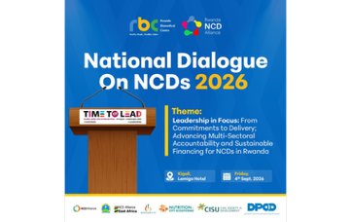
STORY of
IMPACT
On 4 September 2026, the Rwanda NCD Alliance and Rwanda Biomedical Centre convened the country’s first National Dialogue on NCDs as part of the Global Week for Action. The meeting brought government representatives together with health professionals, development partners, civil society and people living with NCDs as Rwanda prepares its National NCD Strategy and Costed Action Plan for 2026–2030.
Participants called for stronger domestic financing, increased use of health-promoting fiscal measures and greater investment in affordable medicines, diagnostics and medical devices. They also highlighted the need for better surveillance and accountability systems to guide policy and monitor progress.
The dialogue examined progress in bringing NCD services closer to communities through primary healthcare and Community-Based Health Insurance, while recognising that specialised treatment remains unaffordable for many families. People living with NCDs called for easier access to diagnosis, medicines and appropriate care.
The dialogue created a national platform for defining priorities and connecting government policy with civil society evidence and lived experience. Its discussions are intended to inform Rwanda’s next NCD strategy and preparations for IFD3. The next measure of influence will be how clearly these priorities appear in the new strategy, financing arrangements and systems established to track delivery.
RWANDA
First national NCD dialogue puts financing and accountability at the centre
2026 Global Week for Action Impact Report
16

Slide 16
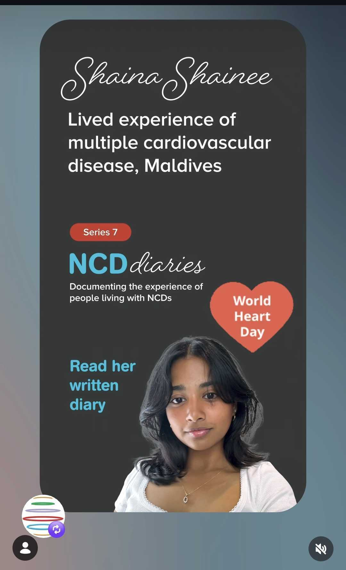
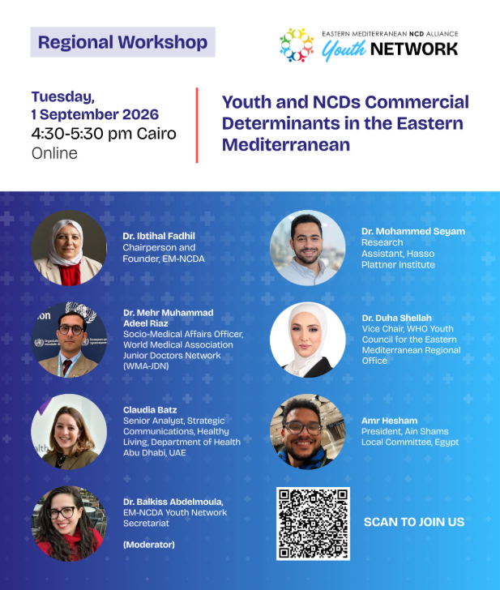
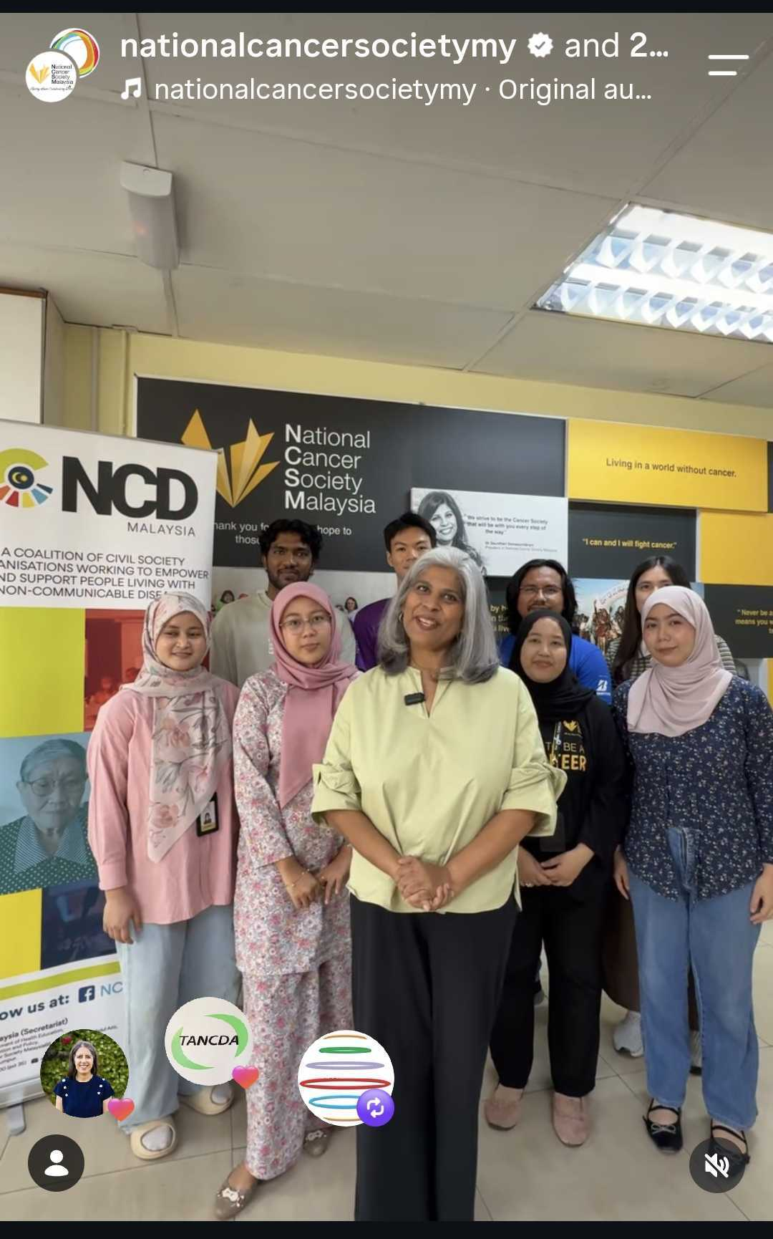
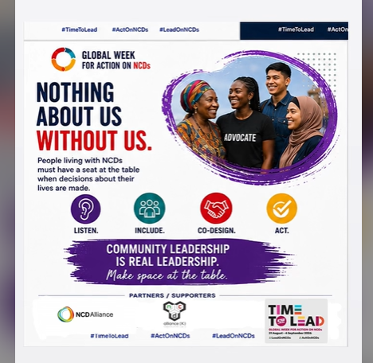
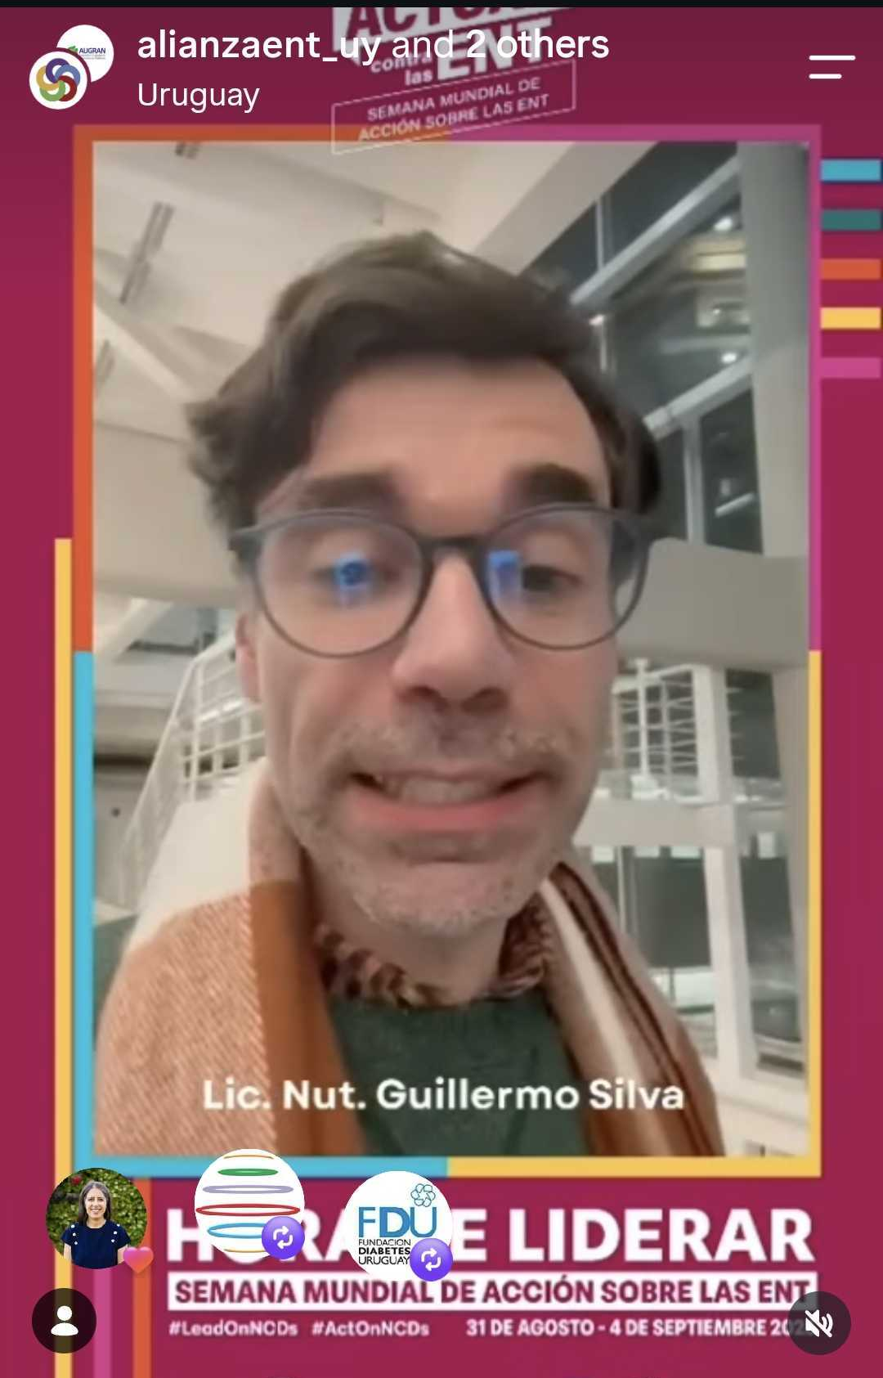
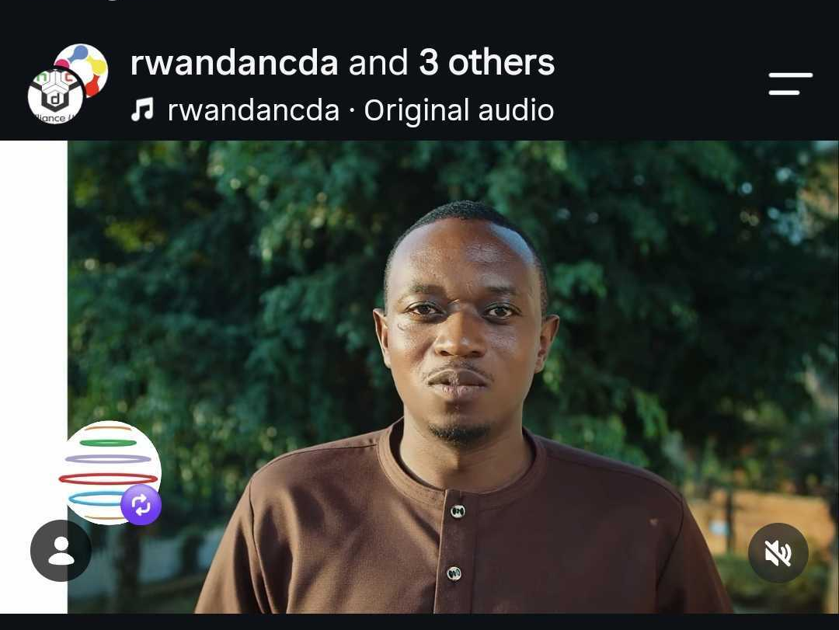
ONE MESSAGE, MULTIPLE VOICES
The 2026 Global Week for Action produced some of the most-viewed social media posts in the campaign’s history. The five posts highlighted here came from people with lived experience and national and regional alliances, each bringing the campaign to its audiences through its own voice and context.
ADD TOP-PERFORMING
ALLIANCE POST 1
ADD TOP-PERFORMING
ALLIANCE POST 2
ADD TOP-PERFORMING
ALLIANCE POST 3
ADD TOP-PERFORMING
ALLIANCE POST 4
ADD TOP-PERFORMING
ALLIANCE POST 5
The attention they attracted shows how the alliance network extended the Global Week far beyond NCDA’s own channels. By carrying a shared message into different countries and communities, these posts helped make the call for leadership on NCDs more visible around the world.
2026 Global Week for Action Impact Report
17

Slide 17
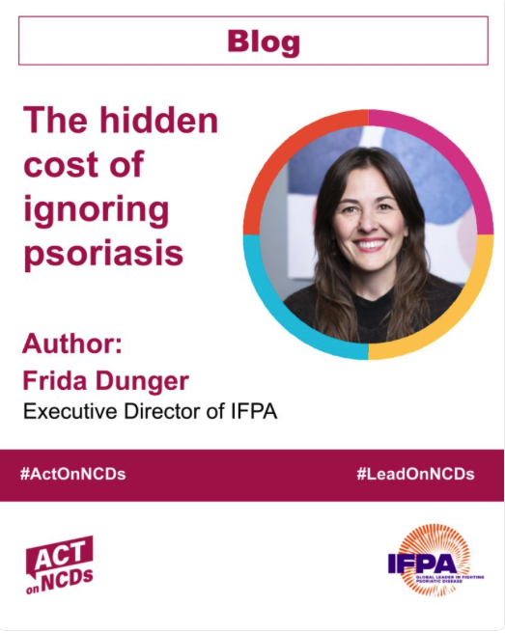
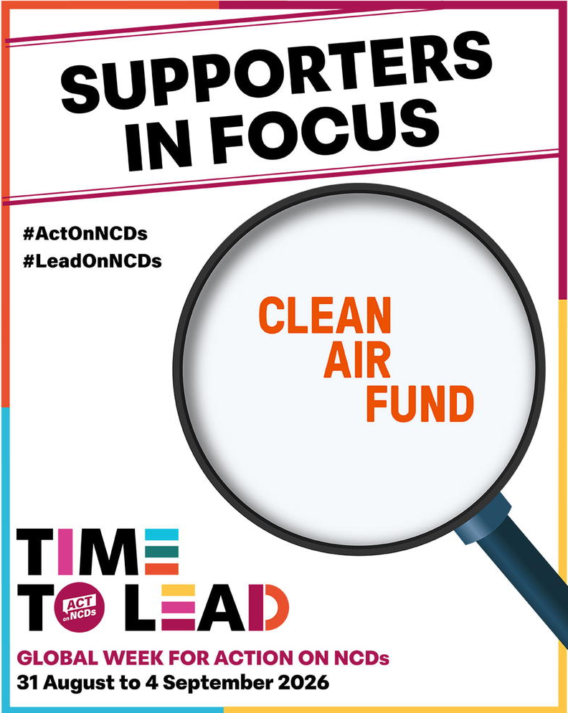

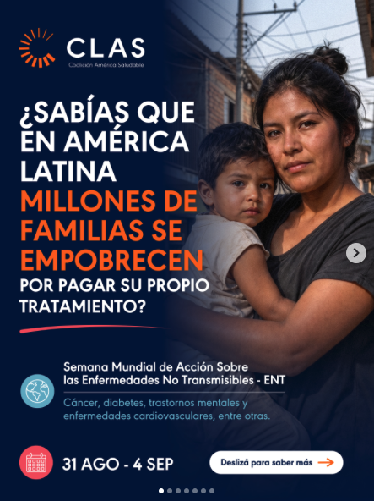
MEMBER AND SUPPORTER ENGAGEMENT
The 2026 Global Week for Action was shaped by contributions from across the NCDA network. Members and supporters organised activities, adapted campaign messages for their own contexts, shared evidence and resources, and brought the experiences of their communities into the global conversation.
This collaboration was visible from the opening World Tour, which carried videos from members and supporters across regions and time zones. It continued throughout the week through national policy dialogues, community events, media engagement and digital advocacy.
At the time of writing, more than 380 events and activities had been recorded worldwide, with further reports still coming in.
This participation connected the global focus on financing and accountability with national realities and ensured that calls for implementation came from those working directly to secure change.
380+
Events and activities recorded worldwide
and still counting
A shared platform for locally grounded advocacy with a collective global voice
2026 Global Week for Action Impact Report
18

Slide 18
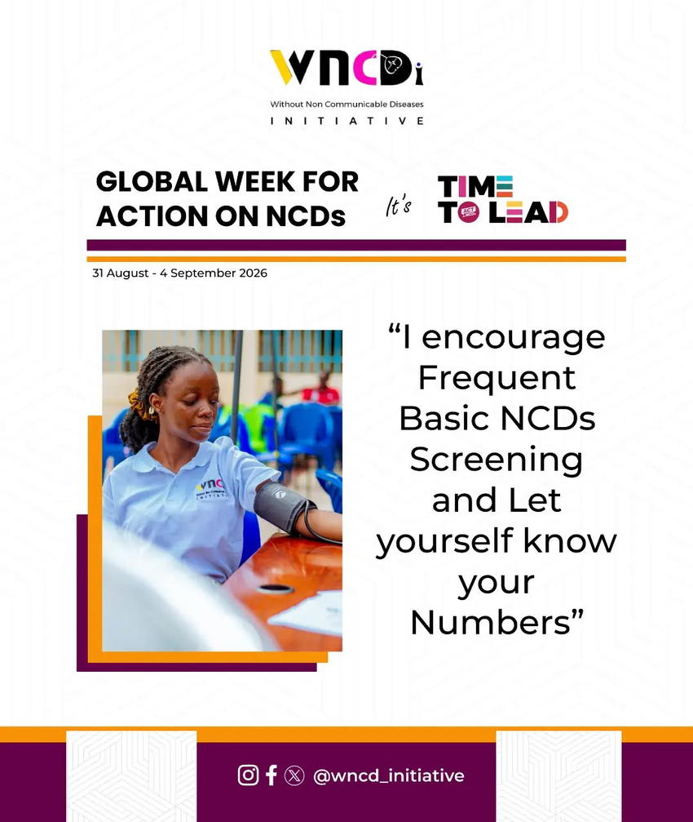
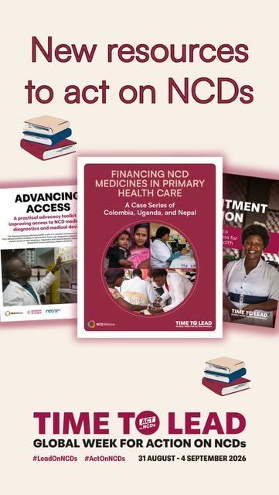
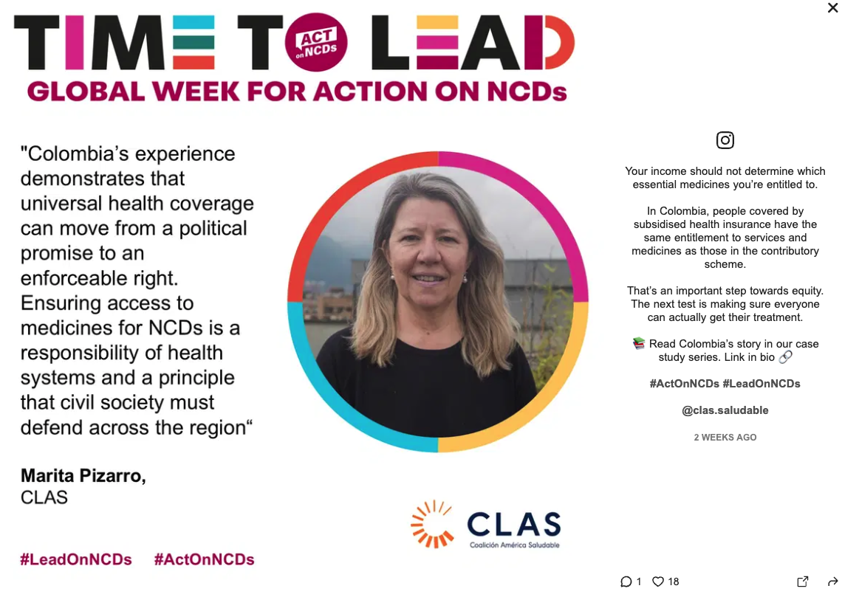
STORYTELLING ASSETS
Stories, evidence and tools for action
The 2026 campaign brought together stories, policy evidence and practical tools to help move the conversation from commitment to implementation.
The content gave advocates a common foundation while leaving room to adapt messages to their own priorities, audiences and national contexts.
Use the following pages to showcase the strongest examples rather than every asset produced.
2026 Global Week for Action Impact Report
19

Slide 19
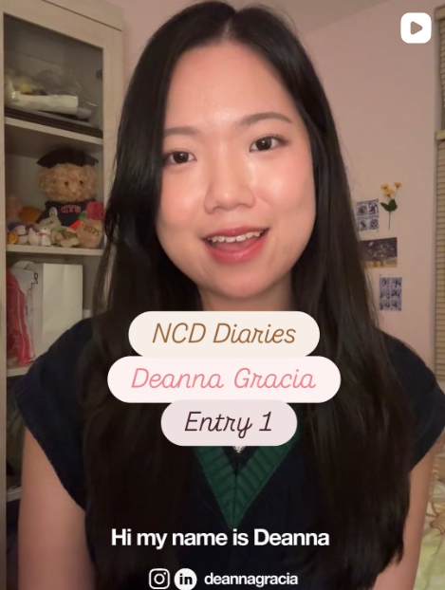

NCD DIARIES
Young Voices in Focus
Launched during the 2026 Global Week for Action, the seventh NCD Diaries series, Young Voices in Focus, puts young people’s experiences of living with NCDs at the centre of the conversation.
Through written, visual and podcast diaries, advocates share the challenges they face and how these experiences have inspired them to advocate for change. Their stories bring attention to perspectives often missing from mainstream discussions on NCDs, highlighting the importance of involving young people in shaping the policies that affect their lives.
Among them is Deanna Gracia from Indonesia, who lives with Graves’ disease. Through her visual diary, she shares her experiences of living with an autoimmune condition and finding connection with others, using her story to raise awareness and support other young adults.
​
“Living with a chronic disease as a young person is never easy, but I hope to raise awareness and support other young adults like me through these diary entries.”​
Deanna Gracia, Indonesia​
Explore the Young Voices in Focus series.​
​
2026 Global Week for Action Impact Report
19

Slide 20



BLOGS AND MULTIMEDIA CONTENT
Member and supporter-authored blogs brought expertise and experience from across the NCD community into the campaign. Contributors explored issues ranging from health taxes and investment in the health workforce to access to care, humanitarian settings and the leadership of young people.
LEADERSHIP DIALOGUES
The 2026 series explored climate and health, the changing global health landscape and the role of fiscal policy in protecting health and advancing sustainable development. The latest dialogue brought together Jeremias Paul (WHO Fiscal Policies –Ret.) and Paula Johns, Executive Director of ACT Promoção da Saúde, Brasil.
ADD SECOND
MEMBER BLOG
2026 Global Week for Action Impact Report
20

Slide 21





KNOWLEDGE EXCHANGE
What could one Dollar buy?
Sharing best practice & other resources for action
Adaptable social media cards invited participants to show what one dollar could mean in their context, whether it helped cover transport to a clinic, essential medicine, a healthy meal or a basic diagnostic test. The posts connected large financing debates with everyday decisions that affect people’s ability to prevent or manage an NCD.
The Advancing Access package combined a global policy brief with a practical toolkit to help advocates identify barriers to medicines, diagnostics and medical devices and develop evidence-based asks. Country case studies from Colombia, Uganda and Nepal examined how different health systems are financing NCD medicines through primary healthcare.
Civil society action guides, adaptable media materials, social media content and resources for engaging governments ahead of IFD3 helped turn this evidence into action.
2026 Global Week for Action Impact Report
21

Slide 22
DIGITAL ENGAGEMENT AND ANALYTICS
1 July to 30 September 2026
WEBSITE
SOCIAL MEDIA
VIDEO CONTENT
16,080
328,796
85,352
users
social media views
video views
20,307
30,538
14,008
4%
sessions
page views
13,661
interactions
Avg monthly engagement rate
22 sec
34%
minutes watched
average engagement
engagement rate
820
719 downloads | 11 resources | 10 blogs
new followers
Engagement rates remained above sector medians.
These results were achieved with a smaller volume of content than in previous years, supported by organic promotion and no paid advertising.
2026 Global Week for Action Impact Report
22

Slide 23
DIGITAL ENGAGEMENT AND ANALYTICS
Impact across three campaign years
WEBSITE
SOCIAL MEDIA
VIDEO CONTENT
90,966
7,984,000
1,514,720
users
social media views
video views
149,962
213,655
95,000
6%
sessions
page views
496,413
interactions
Avg monthly engagement rate
23 sec
35%
minutes watched
average engagement
engagement rate
6,076
2,142 downloads | 72 resources | 82 blogs
new followers
Engagement rates remained above sector medians.
*These numbers are for the three-year campaign, 15 Sep - 11 Nov 2024, 18 Aug - 2 Oct 2025 and 1 July – 30 Sept 2026 combined.
2026 Global Week for Action Impact Report
23

Slide 24

LOOKING FORWARD
The road to Manila & UNHLM on UHC
​
The Financing Dialogue will mark the culmination of the three-year Time to Lead campaign. The experience, evidence and relationships built through the campaign will then feed into NCDA's next long-term campaign strategy, and connect with the work on NCD financing with the journey towards the 2027 UN High-Level Meeting on Universal Health Coverage.
​
The 2026 Global Week for Action marked the next stage of Time to Lead. With the third International Dialogue on Sustainable Financing for NCDs and Mental Health (IFD3) rescheduled for 16–18 February 2027, the campaign now has an extended final leg in which to strengthen the evidence, sustain political attention and press for concrete action on NCD financing.
The NCD Financing Tracker will remain central to this work. NCDA members and supporters will continue to contribute examples of national and regional action.
The findings will be shared at IFD3, bringing practical experience from across the NCD community into the global financing discussion.
2026 Global Week for Action Impact Report
20
24

Slide 25


